Slide 1
Walmart Data Exploration
Questions & Answers on Anonymized Data

Slide 2
Table of Contents
Why I chose this dataset
About Walmart
The dataset
Assumptions
Sales introduction
Types of stores
Seasonality
Markdowns
Temperature
Challenges & what I’ve learned
To improve
How I worked
What’s next
Q&A

Slide 3
Why I chose this dataset
Business data:
Pain points in career
Use knowledge to advance business
Time series:
Search for trends, seasonality, holiday & promos impact
Forecasting

Slide 4

About Walmart
Funded in 1962 by Sam Walton
10,586 stores
24 countries
$570 billion annual revenue
2.2 million employees

Slide 5

The dataset
45 USA stores
3 types of store
400K+ rows
Feb 5 2010 to Nov 1 2012*
Markdown data is only available after Nov 2011, and is not available for all stores all the time

Slide 6
Assumptions
The initial SQL DB will emulate a production DB, so the import of the original files will only have to be made once.
Negative sales mean that there have been more returns than sales
Store size is in square feet
Temperature is in degrees Fahrenheit
Money is US$
Long numbers in Unemployment and CPI are decimal numbers missing the separator
US formatting of dates and numbers
Department numbers refer to the same departments across all stores

Slide 7
Sales Intro
Total sales in period: $606,10 bn
Best week in store: $69,31 m
Worst week in store: $-498,89 k

Slide 8
Types of stores
Types represent income buckets
Can’t tell if same as official types of stores because of size similarities

Slide 9
Seasonality
Thanksgiving & Christmas bring the more revenue
Much smaller peak in lower income stores
Superbowl & Saint Valentine weeks bring stores out of January slump

Slide 10
Sales vs Markdowns
Markdowns seem to be correlated with increases in sales

Slide 11
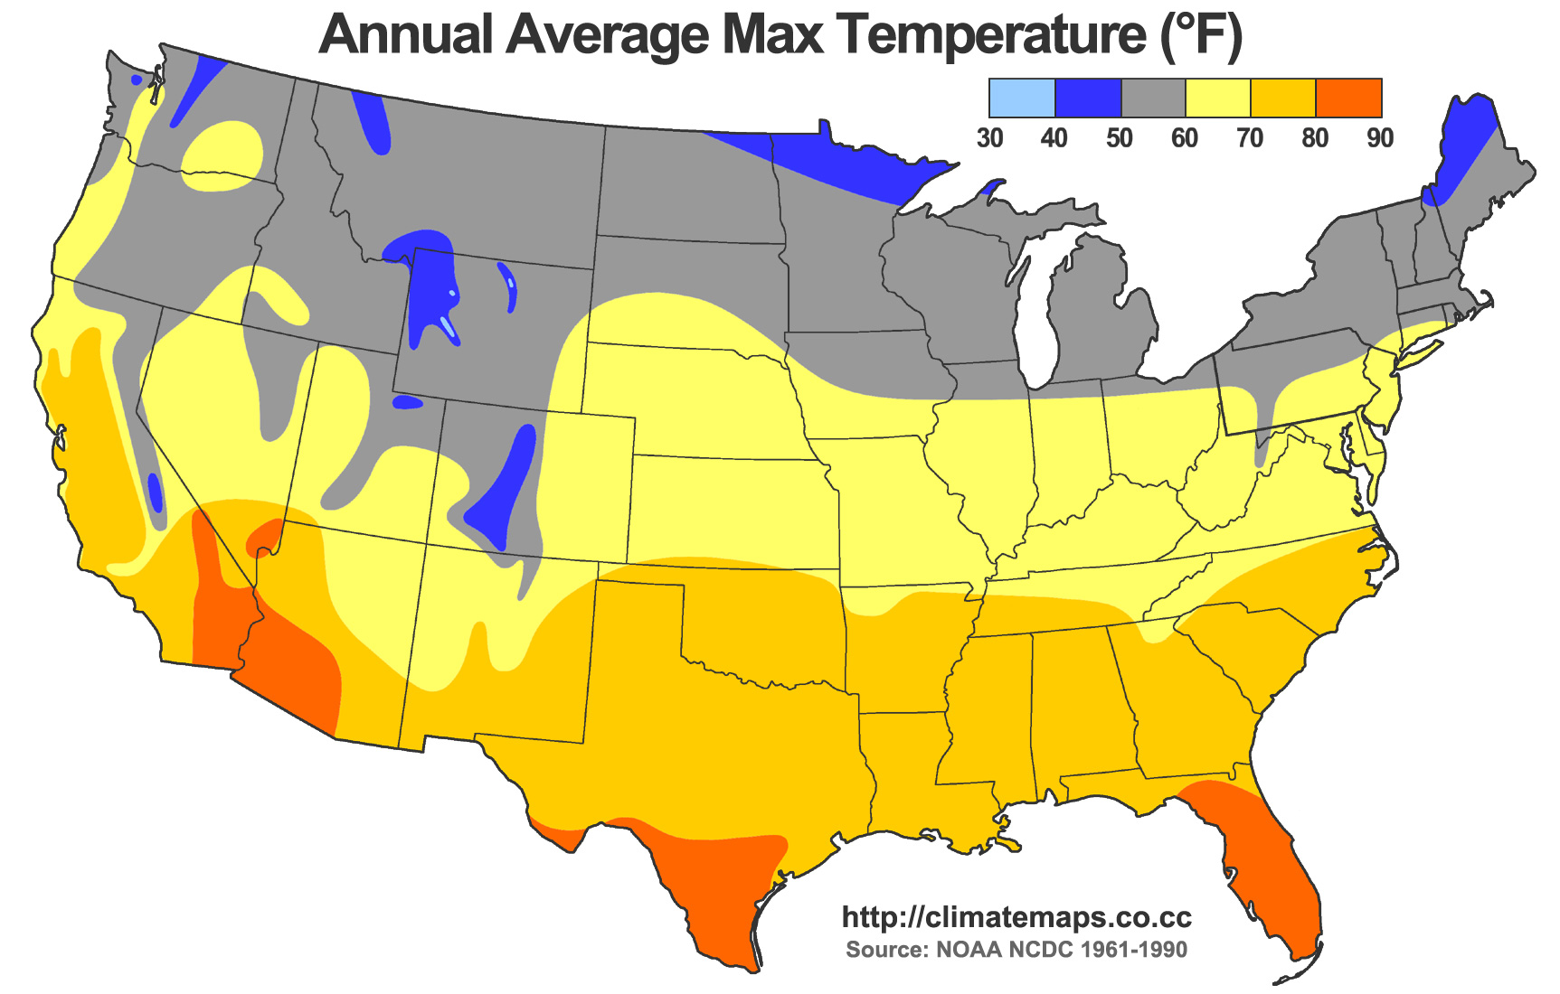
Sales vs Temperature
False correlation between sales and temperature driven by end of year sales?
Most stores in dataset are not in north of US

Slide 12
Challenges & what I’ve learned
Challenges:
Not enough knowledge of statistics
Could not do forecasting
Remote work issues with SSIS & Power BI
Long delays for minor issues
Working with weekly sales data
Highlight chart areas
Renaming booleans on chart
Learned:
Improved data analytics knowledge
Improved practical knowledge of tools
Documented issues and improved intuition
I want to do a lot more in data analytics

Slide 13
To improve
Statistics
Forecasting
Machine learning

Slide 14
How I worked
Toolstack:
TSQL & SSMS
Visual Studio SSIS
Power BI
Google Slides
Obsidian + Hugo

Slide 15
What’s next
Machine learning & statistics courses
Data exploration with Python
Power BI certification

Slide 16
Q&A
Questions?

